Slide 1
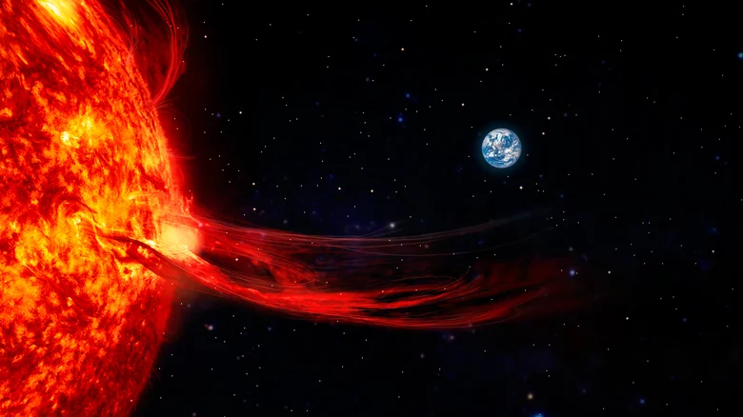
NASA SWxC CLEAR: All-Clear SEP Forecast
Transition Steps to CCMC
Lulu Zhao and the CLEAR Team
CLEAR Team: I. Sokolov, C. N. Arge, Y. Chen, W. Manchester, B. van der Holst, C.M.S. Cohen, G. Li, A. Bruno, I. G Richardson, D. Lario, Y. Omelchenko, M. Jin, N. Sachdeva, Z. Huang, K. D. Leka, H. M. Bain, M. Leila, K. Whitman, J. Giacalone

Slide 2
Outline
CLEAR Tools
Current Status at CCMC
Future Steps and Challenges
Notes:
In our current understanding, there are two physical phenomenon on the sun that are related to the acceleration of energetic particles. One is the solar flares, and the other is coronal mass ejection. As shown in the left two movies, Solar flares are large eruptions of electromagnetic radiation from the Sun and the coronal mass ejections are large expulsion of plasma and magnetic field from the solar corona. If you place a particle detector somewhere in the space, you calculate the particle flux as shown in the right panel. This is a typical SEP event, the particle flux at different energies are plotted, showing from low energy in the top and high energy in the bottom. What usually cause a concern is the proton flux at energies greater than 10 MeV, anything above the second curve from the top.

Slide 3
CLEAR SWxC
All-Clear SEP Forecast
Provide pre-eruption and post-eruption probabilistic forecasts of SEP events
Forecast post-eruption SEP event key parameters
Predict periods of SEP intensities below a preset threshold to issue all-clear forecasts
Notes:
In our current understanding, there are two physical phenomenon on the sun that are related to the acceleration of energetic particles. One is the solar flares, and the other is coronal mass ejection. As shown in the left two movies, Solar flares are large eruptions of electromagnetic radiation from the Sun and the coronal mass ejections are large expulsion of plasma and magnetic field from the solar corona. If you place a particle detector somewhere in the space, you calculate the particle flux as shown in the right panel. This is a typical SEP event, the particle flux at different energies are plotted, showing from low energy in the top and high energy in the bottom. What usually cause a concern is the proton flux at energies greater than 10 MeV, anything above the second curve from the top.

Slide 4
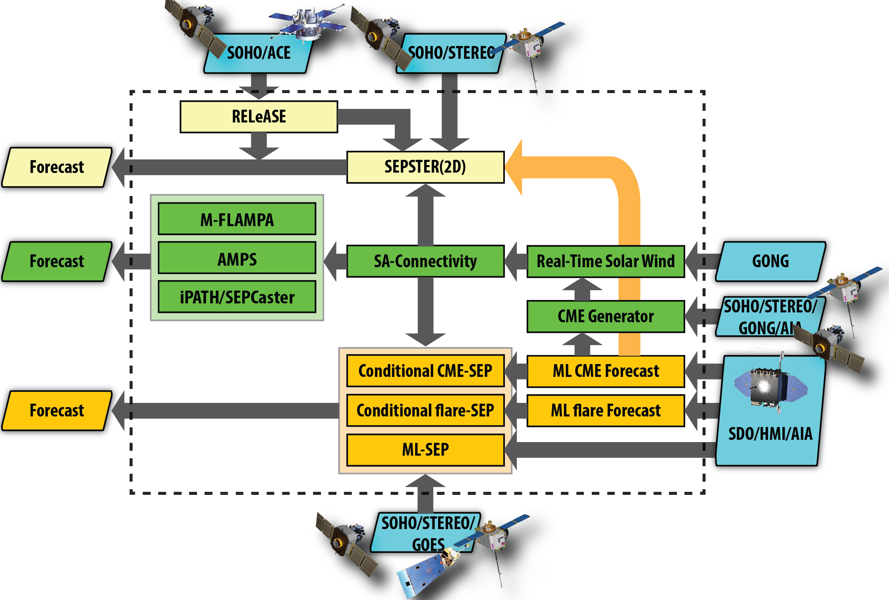
CLEAR Framework
Empirical
Machine Learning
Physics-based
Individual & Integrated models
Notes:
In our current understanding, there are two physical phenomenon on the sun that are related to the acceleration of energetic particles. One is the solar flares, and the other is coronal mass ejection. As shown in the left two movies, Solar flares are large eruptions of electromagnetic radiation from the Sun and the coronal mass ejections are large expulsion of plasma and magnetic field from the solar corona. If you place a particle detector somewhere in the space, you calculate the particle flux as shown in the right panel. This is a typical SEP event, the particle flux at different energies are plotted, showing from low energy in the top and high energy in the bottom. What usually cause a concern is the proton flux at energies greater than 10 MeV, anything above the second curve from the top.

Slide 5
CLEAR Tool Delivery Timeline
SEP Dataset
EEGGL & TD
Integrated Models
Validated CLEAR
Year 1
2025
Year 3
2027
Year 5
2024
Year 2
2026
2028
Year 4
Validated Individual Models
Validated Integrated Models
Notes:
In our current understanding, there are two physical phenomenon on the sun that are related to the acceleration of energetic particles. One is the solar flares, and the other is coronal mass ejection. As shown in the left two movies, Solar flares are large eruptions of electromagnetic radiation from the Sun and the coronal mass ejections are large expulsion of plasma and magnetic field from the solar corona. If you place a particle detector somewhere in the space, you calculate the particle flux as shown in the right panel. This is a typical SEP event, the particle flux at different energies are plotted, showing from low energy in the top and high energy in the bottom. What usually cause a concern is the proton flux at energies greater than 10 MeV, anything above the second curve from the top.

Slide 6
CLEAR Individual Tools
Empirical
SESPTER (2D): Predict SEP Flux Using CME infomation
RELeASE: Predict upcoming proton from electrons
Machine Learning
ML-flare: Predict flare probability and x-ray flux
ML-CME: Predict CME probability and CME speed
ML-SEP: Predict SEP probability and proton flux
Physics-based
AWSoM-R: Magnetic connectivity model
EEG-GL/TD: CME generation and propagation
MFLAMPA, IPATH, AMPS, PARMISAN: Particle tracker
Notes:
In our current understanding, there are two physical phenomenon on the sun that are related to the acceleration of energetic particles. One is the solar flares, and the other is coronal mass ejection. As shown in the left two movies, Solar flares are large eruptions of electromagnetic radiation from the Sun and the coronal mass ejections are large expulsion of plasma and magnetic field from the solar corona. If you place a particle detector somewhere in the space, you calculate the particle flux as shown in the right panel. This is a typical SEP event, the particle flux at different energies are plotted, showing from low energy in the top and high energy in the bottom. What usually cause a concern is the proton flux at energies greater than 10 MeV, anything above the second curve from the top.

Slide 7
CLEAR Integrated Tools
SEPSTER (2D) & RELeASE
AWSoM-R & SEPSTER (2D)
ML-CME & Physics-based Models
Notes:
In our current understanding, there are two physical phenomenon on the sun that are related to the acceleration of energetic particles. One is the solar flares, and the other is coronal mass ejection. As shown in the left two movies, Solar flares are large eruptions of electromagnetic radiation from the Sun and the coronal mass ejections are large expulsion of plasma and magnetic field from the solar corona. If you place a particle detector somewhere in the space, you calculate the particle flux as shown in the right panel. This is a typical SEP event, the particle flux at different energies are plotted, showing from low energy in the top and high energy in the bottom. What usually cause a concern is the proton flux at energies greater than 10 MeV, anything above the second curve from the top.

Slide 8
Current Status at CCMC
Models | CCMC Status | Model Status
SEPSTER | Continuous Run | Completed
SEPSTER (2D) | Continuous Run | Completed
RELeASE | Continuous Run | Completed
AWSoM-R | RoR | Completed
EEG-GL | RoR | Completed
EEG-TD | - | Under development
MFLAMPA | RoR | Completed
IPATH | - | Completed
PARMISAN | - | Under development
AMPS | RoR | Completed
ML models | - | Under development
Integrated models | - | Under development
Notes:
In our current understanding, there are two physical phenomenon on the sun that are related to the acceleration of energetic particles. One is the solar flares, and the other is coronal mass ejection. As shown in the left two movies, Solar flares are large eruptions of electromagnetic radiation from the Sun and the coronal mass ejections are large expulsion of plasma and magnetic field from the solar corona. If you place a particle detector somewhere in the space, you calculate the particle flux as shown in the right panel. This is a typical SEP event, the particle flux at different energies are plotted, showing from low energy in the top and high energy in the bottom. What usually cause a concern is the proton flux at energies greater than 10 MeV, anything above the second curve from the top.

Slide 9
Future Steps and Resources Needed
Robustness of the models
Potential challenges
Data stream
Onboarding process
Continuous maintenance
Human power and coordination
Comment/Questions
Notes:
In our current understanding, there are two physical phenomenon on the sun that are related to the acceleration of energetic particles. One is the solar flares, and the other is coronal mass ejection. As shown in the left two movies, Solar flares are large eruptions of electromagnetic radiation from the Sun and the coronal mass ejections are large expulsion of plasma and magnetic field from the solar corona. If you place a particle detector somewhere in the space, you calculate the particle flux as shown in the right panel. This is a typical SEP event, the particle flux at different energies are plotted, showing from low energy in the top and high energy in the bottom. What usually cause a concern is the proton flux at energies greater than 10 MeV, anything above the second curve from the top.

